Slide 1
Statewide General Assessments of ELA, Math and Science
School Coordinator/Test Administrator Training Template

Slide 2
Disclaimers
DELETE THIS SLIDE BEFORE USING FOR YOUR TRAINING
This training will prepare individuals for the administration of general assessments of ELA, Math and Science (NOT alternate assessments)
This training material does not cover the same material included in Cambium-provided trainings (TA and ATA training modules)
Modules teach the mechanics of administering the assessments
This template can be used for training SCs (DA-facilitated) and individuals administering tests (SC-facilitated)
This template may require editing before use
Based on the unique needs of an SU/SD or school, additional information may be necessary
This training does not negate the requirement to read test manuals
Trainings should be documented using training attendance logs, available on the VTCAP Portal
See Resources slide for a direct link
SC = school coordinator; DA = district test administrator; TA = Test Administrator; ATA = Alternate Assessment Test Administrator

Slide 3
Objectives
Describe
the responsibilities of each role involved in adminstering assessments
Create
a secure test environment
Execute on
relevant test security procedures
Properly administer
assessments in accordance with procedures outlined in the test manuals
Create and maintain
appropriate testing conditions
Provide
appropriate accommodations and supports to students

Slide 4
Roles and Responsibilities: District Test Administrator
The DA is responsible for:
Serving as the local point of contact re: assessments
Disseminating information re: assessments within the SU
Organizing training for SCs
Assuming overall responsibility for implementing assessments in the SU
Upload/edit student information in TIDE

Slide 5
Roles and Responsibilities: School Test Coordinator (SC)
The SC is responsible for:
Coordinating the administration of assessments
Ensuring that testing within the school is conducted in accordance with the test procedures documented in testing manuals and user guides
Establishing test schedules based on the State's assessment window
Working with technology staff to ensure timely computer setup and installations
Ensuring that student information in TIDE is correct and test settings for designated supports and accommodations are applied
Identifying students who may require designated supports and test accommodations and ensuring that testing for these students is done properly and securely
Attending all district trainings and reviewing all manuals and guides for testing
Ensuring all TAS attend school or district training and review online training modules posted on the portal
Establish a secure testing environment
Monitor secure administration of the test
Monitor testing progress, ensuring that all students participate
Investigate and report test security incidences
Attend to any secure testing materials in accordance with policy documented within testing manuals

Slide 6
Roles and Responsibilities: Teacher (TE)
Anyone with the Teachers (TE) designation is responsible for:
Completing test administration training and reviewing all manuals and guides for assessments
Viewing student information prior to testing to ensure that the correct student receives the proper test with the appropriate supports
Reporting any potential data errors to SCs as appropriate
Administering assessments
Reporting potential test security incidents to the SC in a manner consistent with assessment policy and State protocol
Note: TES should be certified school personnel; however, if a paraprofessional or substitute teacher is needed to administer a test, the individual must be fully trained in test administration and test security procedures. A certified teacher should monitor paraprofessionals and a substitute teacher should be monitored by the building principal or another administrator.

Slide 7
Roles and Responsibilities: Test Administrator (TA)
The TA is responsible for:
Attending school or district training and review online training modules posted on the portal
Reviewing all manuals and guides for assessments being administered by the TA
Administering assessments properly and securely
Reporting potential test security incidents to the SC in a manner consistent with assessment policy and State protocol
The TA role in TIDE grants permission to:
Administer assessments
A TA cannot:
View student scores

Slide 8
Creating a Secure Test Environment
Test Security and Related Procedures

Slide 9
Why does test security matter?
The security of assessment instruments and the confidentiality of student information are vital to maintaining the validity, reliability, and fairness of the results.
Violation of test security is a serious matter with far-reaching consequences.
Breaches of test security include, but are not limited to, copying of test materials, failing to return test materials, coaching students, giving students answers, and/or changing students’ answers.
Such acts may lead to the invalidation of an entire school district’s student test scores, disruption of the test system statewide, and legal action against the individual(s) committing the breach including revocation of the individual’s license to teach in Vermont.
A breach of test security may be dealt with as a violation of the Code of Professional Responsibility for Teachers, as well as a violation of other pertinent state and federal law and regulation.
The Vermont Agency of Education (AOE) will investigate all such matters and pursue appropriate follow-up action.

Slide 10
What does a secure test environment look like?
The test environment refers to all aspects of the testing situation while students are testing and includes what a student can see, hear, or access (including access via technology).

Slide 11
Requirements for Before Testing
Instructional materials must be removed or covered
Ex., information that might assist students in answering questions displayed on bulletin boards, dry erase boards, or on charts
Student seating must be arranged
There must be enough space between students to minimize opportunities to look at each other's work
Signage may be used
If helpful, TAs may place a "TESTING – DO NOT DISTURB" sign on the door or use signs to reroute traffic for optimal testing conditions
Please note that instructional materials within a classroom must only be covered/removed for the time when testing is taking place (i.e., not for the entire three-month testing window)

Slide 12
Requirements for During Testing
Provide a quiet environment
Actively monitor students and prohibit access to unauthorized electronic devices
Provide students access only to allowable resources permitted for each specific test or portion of test
Ensure only students who are testing can view test items.
Ensure no form or type of answer key has been developed for test items
Administer tests only through the secure browser
Ensure no unauthorized logging in to the test delivery system

Slide 13
Requirements for During and After Testing
Staff, including those involved with test administration, are not permitted to review student responses or students' notes on scratch paper
Unless needed as a print-on-demand or braille accommodation, no copies of the test content/materials may be made or otherwise retained
No digital, electronic or manual device may be used to record or retain test content/materials
Test materials must not be discussed with or released to anyone via any media
No retaining, discussing, or releasing test materials
Staff, including those involved with test administration, may not review, discuss, or analyze test content/materials at any time before, during, or after testing
All test materials must remain secure at all times

Slide 14
Requirements for After Testing
Test materials cannot be used for instructional purposes
Test materials must be destroyed securely

Slide 15
Printed Materials
Printed materials from the print-on-demand accommodation and scratch paper must be kept in a securely locked room or locked cabinet that can be opened only with a key or keycard by staff responsible for test administration. All test materials must remain secure at all times.
Printed test items/passages, including embossed braille printouts and scratch paper, must be collected and inventoried at the end of each test session and then immediately shredded according to district and/or state policies or procedures. DO NOT keep printed test items/passages or scratch paper for future test sessions except as noted for performance tasks(PTs).

Slide 16
Performance Tasks
The only exception to the requirement governing the destruction of printed materials and scratch paper is when scratch paper is used during the ELA and mathematics PTs.
While the embedded Notes tool is the preferred mode for note-taking during the ELA PT, students may use scratch paper to make notes. To ensure that students using scratch paper for notes have the same allowance as students using the online notes, the TE/TA should tell students to write their names (or some appropriate identifying information) on each piece of scratch paper, collect the scratch paper at the completion of Part 1 of the ELA PT, and securely store it for students’ use during Part 2 of the ELA PT.
Likewise, the mathematics PT may extend beyond one test session. When this happens, the TE/TA should tell students to write their names on the scratch paper (and graph paper for grades 6 and above), collect the paper used in the first session, and securely store it for students’ use in the subsequent test session.
Following the conclusion of the PT, all scratch paper and graph paper must be collected, inventoried, and immediately destroyed to maintain test security

Slide 17
Executing on relevant test security procedures
Test Security and Related Procedures

Slide 18
What is a test security incident?
Any deviation in test administration is known as a test security incident.
Test security incidents, such as improprieties, irregularities, and breaches, are behaviors prohibited either because they give a student an unfair advantage or because they compromise the security of the assessments.
Whether intentional or by accident, failure to comply with security rules, either by staff or students, constitutes a test security incident.
Improprieties, irregularities, and breaches need to be reported in accordance with the instructions in the Test Security Incident Procedure Document. Definitions for test security incidents are provided in Table 9 on p. 21 of the Test Coordinator Manual.

Slide 19
What types of test security incidents should I be aware of?
Impropriety
Low risk, low impact
Can be corrected and contained at the school level
Must be reported to SC and DA immediately
Must be submitted in the Appeals module in TIDE if student testing is impacted
Irregularity
Impacts students and may potentially affect student performance, test security, or test validity
Can be corrected or contained at the school or SU level
Must be reported to SC and DA immediately
Must be submitted in Appeals module in TIDE if student testing is impacted
Breach
Poses threat to the validity of the test
Must be reported to SC and DA immediately
Must be submitted in Appeals module in TIDE if student testing is impacted

Slide 20
If I observe an impropriety, what is my responsibility?

Slide 21
If I observe an irregularity, what is my responsibility?

Slide 22
If I observe a breach, what is my responsibility?

Slide 23
Who should I contact with questions about test security?
First, consult existing documentation (TCM, TAM, TIDE User Guide, UAAG)
If the answer is not found,
TAs should contact the SC
SCs should contact the DA for the SU
DAs should contact the AOE

Slide 24
Properly administering statewide assessments
Roles and responsibilities before, during, and after testing

Slide 25
What does it mean to administer an assessment properly and why is this important?
A proper, and therefore standardized, administration guarantees that all students are tested under the same conditions. This supports results being compared across students, schools, SUs, and years.
A standardized administration minimizes error in test scores and reduces bias.

Slide 26
Testing Schedule
Vermont's testing window: March 15 – June 10 (May 30 – June 10 reserved for make-up testing)
[Please insert SU or school testing window/schedule]

Slide 27
Testing Schedule
ELA
Grades 3-8: 3 hours 30 minutes
Grade 9: 4 hours
Math
Grades 3-5: 2 hours 30 minutes
Grades 6-8: 3 hours
Grade 9: 3 hours 30 minutes
Science
All grades: 60 minutes per session
These estimates do not account for any time needed to start computers, load secure browsers, and log in students. Nor do they account for breaks. TEs/TAs should work with SCs to determine precise testing schedules.

Slide 28
Before Testing: SC
Prior to the start of testing, each SC is expected to
Attend training facilitated by DA and complete training attendance log
Train all individuals administering assessments
Verify student demographic information and test settings in TIDE
Verify that students are provided the opportunity to practice on the Training Test and Practice Test prior to testing
Verify that students are familiar with all item types prior to testing
Ensure that all TAs have login information for the TA interface
Ensure the correct version of the secure browser is on each device to be used for testing
Ensure that TAs have all necessary login information
Prior, during, and after testing, adhere to test security policy and school procedures, including establishing appropriate testing conditions
Prior, during, and after testing, report test security incidents to the DA in a manner consistent with state and district policies.

Slide 29
Before Testing: TA
Prior to administering a test, each Test Administrator is expected to:
Read SBAC and/or VTSA TAM
Receive and activate a TIDE account
Attend training faciliated by SC and complete training attendance log
Complete the Non-embedded Accommodation Non-disclosure Agreement if administering any non-embedded accommodations
Complete the TA Certification course
Check to ensure the secure browser is available on each student testing device
Provide students opportunities to practice and prepare, including the Training Test and Item Type Tutorials
Review student information with the School Testing Coordinator to ensure each applicable student receives the proper test with the appropriate supports
Receive necessary materials for students, including scratch paper, testing tickets, and any applicable accommodations materials from the School Test Coordinator
Immediately before testing, provide students with necessary login information including first name, SSID, and the test session ID to log into atest
Immediately before testing, provide students with scratch paper and any other necessary materials, including handheld calculators, if providing
Prior, during, and after testing, adhere to test security policy and school procedures, including establishing appropriate testing conditions
Prior, during, and after testing, report all potential test security incidents to the School Test Coordinator in a manner consistent with state and district policies.

Slide 30
During Testing
TA: Log into the TA Interface to create, start, monitor, and end the test session
TA: Provide students with approved materials (e.g. graph paper, accommodation supplies)
TA: Follow test administration script exactly
TA: Report test security incident to SC immediately
SC: Report test security incident to DA immediately

Slide 31
During Testing: Submitting Appeals
For security incidents that result in a need to reset, reopen, allow a grace period extension, restore, or invalidate individual student tests, the AOE must approve the request.
AOE approvals and denials will, in most cases, be processed within 24 hours.
In most instances, an appeal will be submitted to address a test security breach or irregularity. In some cases an appeal may be submitted to address incidents that are not security related such as reopening an assessment for a student who becomes ill and is unable to resume testing because the test has expired.
Because the Appeals system is for action only, all appeals should also be entered in the Test Security Incident Log and submitted to the DC/SC.
The Test Security Incident Log includes the information needed to process an appeal.
See pages 22-28 of the Test Coordinator Manual for detailed instructions on how and when to submit an appeal through TIDE.

Slide 32
After Testing: SC
Confirm materials have been destroyed in accordance with procedures outlined in the TCM (page 35)
Confirm that principal has submitted the Certification of Proper Test Administration
Ensure non-participation codes have been entered in TIDE for any student who is exempt from testing (see TIDE User Guide for list of exemptions)

Slide 33
After Testing: TA
Destroy test materials (See page 35 of the TCM)
Upon completion of paper tests, submit student responses to standard paper, large print, and braille paper tests in the Data Entry Interface (DEI).

Slide 34
Who do I contact if I have questions about test administration?
First, consult existing documentation (TCM, TAM, TIDE User Guide, UAAG)
If answer is not found,
TA's should contact the SC
SC's should contact the DA for the SU
DA's should contact the AOE

Slide 35
Creating and maintaining appropriate testing conditions
Standardized administration

Slide 36
Setting up the testing space
Establish procedures to maintain a quiet testing environment throughout the test session, recognizing that some students will finish more quickly than others.
If students are allowed to leave the testing room when they finish, explain the procedures for leaving without disrupting others and where they are expected to report once they leave.
If students are expected to remain in the testing room until the end of the session, instruct them on what activities they may engage in after they finish the test. The activity should not be related to the test being given (e.g. work on assignments for unrelated subjects or read a book).

Slide 37
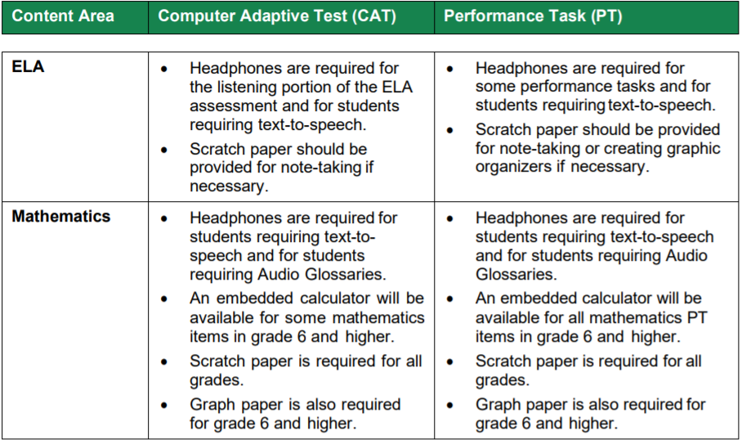
What is allowed in the testing space?
During test administration, students may have access to and use of these additional required resources

Slide 38
Providing appropriate accommodations and supports to students
Accommodating test administration

Slide 39
What supports are offered?

Slide 40
How are accommodations entered for students?
DAs and SCs can set embedded and non-embedded designated supports and accommodations in TIDE. Designated supports and accommodations must be set in TIDE prior to starting a test session.
For additional information about the availability of designated supports and accommodations, refer to the Usability, Accessibility, and Accommodations Guidelines. For information on updating student settings, refer to the TIDE User Guide. The TA User Guide also contains information on how to use some of these settings.

Slide 41
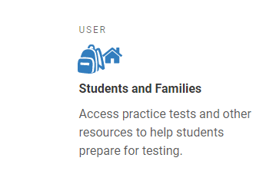
Are students required to use accommodations?
Students must be offered accommodations listed in the IEP but can refuse to use them
Student cannot be denied an approved testing accommodation.
Students must be trained on how to use the accommodations assigned.
Training Tests
Practice Tests

Slide 42
How can I become trained on properly administering accommodations?
Tools for Teachers (T4T) website
ISAAP Tool (Individual Student Assessment Accessibility Profile)
Accessibility Tools – short videos
Vermont Comprehensive Assessment Program Portal
Specific Assessment's Accessibility Manual
Appendices provide streamlined and specific administration guidelines.
Do not assume that the manual for one assessment contains the same accommodations, or administration protocols, as another assessment.
Accommodations vary by content and constructs being measured and can vary within content subject matter. (ex. Protocols for writing – extended response vs brief response)
Accommodations 101 Training (Pdf) / Video

Slide 43
How can I maintain test security while administering non-embedded accommodations?
General FAQs found in the Usability, Accessibility, and Accommodations Guide (UAAG). (#12)
Be sure to follow any posted accommodation guidelines as most will give information on keeping the test items and student information secure. (ex. Guidelines for Simplified Test Directions)
All test material, paper or online, is considered secure. Anyone who is administering an assessment with a non-embedded accommodation must sign a Non-Embedded Accommodations Non-Disclosure Agreement

Slide 44
How do I know if a student should take the general assessment or the alternate assessment?
The decision on how to assess a student is an IEP Team decision guided by the State's Eligibility Criteria Checklist.
View: VTAA Test Selection Process & LCI Training video

Slide 45
Who do I contact if I have questions about accommodations and accessibility?
First, consult existing documentation (TCM, TAM, TIDE User Guide, UAAG)
If answer is not found,
TAs should contact the SC
SCs should contact the DA for the SU
DAs should contact the AOE

Slide 46
Resources
School Coordinator Training Log
Test Administration Training Log
Test Coordinator Manual
Test Administration Manual – Smarter Balanced
Test Security Incident Procedure
Test Participation Guidance
Accommodations training
Assurances overview
Non-embedded accommodations NDA
Test Administration Manual - Science

